Slide 1
Encoding Text

Slide 2
Text and Binary Data
Up till this point in the course, we’ve been moving up to bigger and bigger code structures
From ints and floats, to lists and strings, to modules and classes
Today, we’re heading in the other direction.
We want to know how a computer can store all the types of data we use, when at some level it’s all binary, just zeros and ones.
When we’re just working in Python, we usually don’t have to worry about this level of representation
But as a data scientist, you’ll often need to collect data from other sources
Websites
Publically advertised servers
Files created by other people
We can classify these sources as text data or binary data. Let’s cover text data first

Slide 3
Text
How can we get a computer to process text characters?
We know that at some level, text has to be binary, so need to map each character to a binary sequence
You can view every binary sequence as a number in base 2
0000 is 0
0001 is 1
0010 is 2
And so on…
The first major system for encoding text was called ASCII
American Standard Code for Information Interchange
It was first published in 1963
Every ASCII character takes 7 bits
This means that you can only get 2⁷ = 128 different characters.

Slide 4
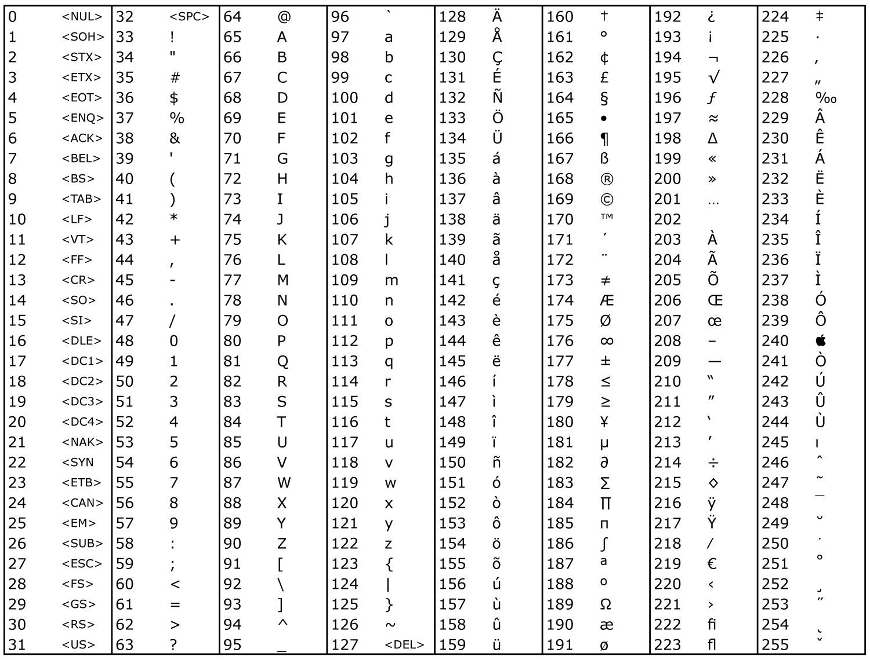
ASCII

Slide 5
Beyond ASCII
Of course, ASCII was far too limiting.
It doesn’t even cover all the characters we use to write English, let alone other major languages.
There have been a lot of attempts to create larger character encodings.
Windows code, Latin-1, etc
These, are unfortunately, often incompatible, and cause errors if you don’t know exactly how to process the bits you’re getting.

Slide 6
Unicode
The closest thing we have to a standard is a system called Unicode.
This defines a set of more than 120,000 different characters.
Modern languages, ancient languages, mathematical symbols.
Unicode is actually an abstraction, essentially just assigning an order to characters.
There are then character encodings that take each unicode character and map it to a sequence of bytes.
The most popular one is UTF-8.
The 8 stands for 8 bits, or one byte. Every character in UTF-8 gets 1 to 4 bytes.
The original ASCII characters are encoded with 1 byte using their original ASCII encoding. So UTF-8 is very compact for these characters.

Slide 7
Unicode
UTF-8 is becoming a popular standard.
85.1% of all Web pages in September 2015
This is what you want to use if you have a choice.
But there are times when you have to interact with other encodings in Python.
We’ll explore how to encode and decode text in the next segments.

